Slide 1
Statistics for Reporters
Sean McMinn
Digital frameworks
Northwestern University – Summer 2018
Github.com/shmcminn/digitalframeworks-summer18

Slide 2
Data stories?

Slide 3
Steps to a data story
Find data
Clean data
Analyze data
Present data

Slide 4
Agenda
Examples
Guest: Anthony DeBarros (tentative)
Statistical concepts you should know

Slide 5
Statistics for reporters
Summarize information
Mean, median, mode
Make comparisons/correlations
Averages/trends between groups
Make “predictions”
Use past data to predict future or missing data
**this is risky**

Slide 6
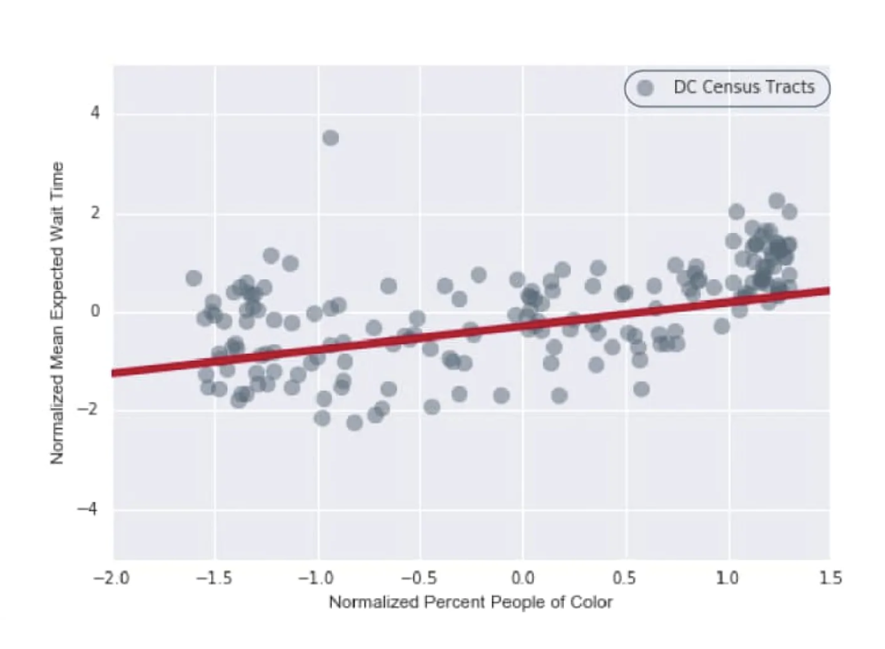
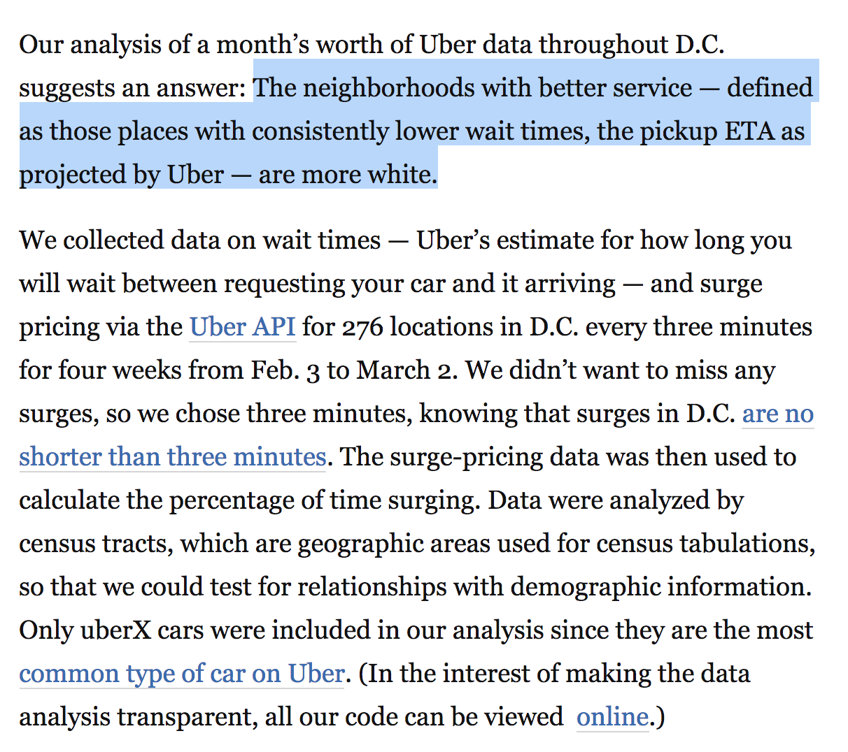
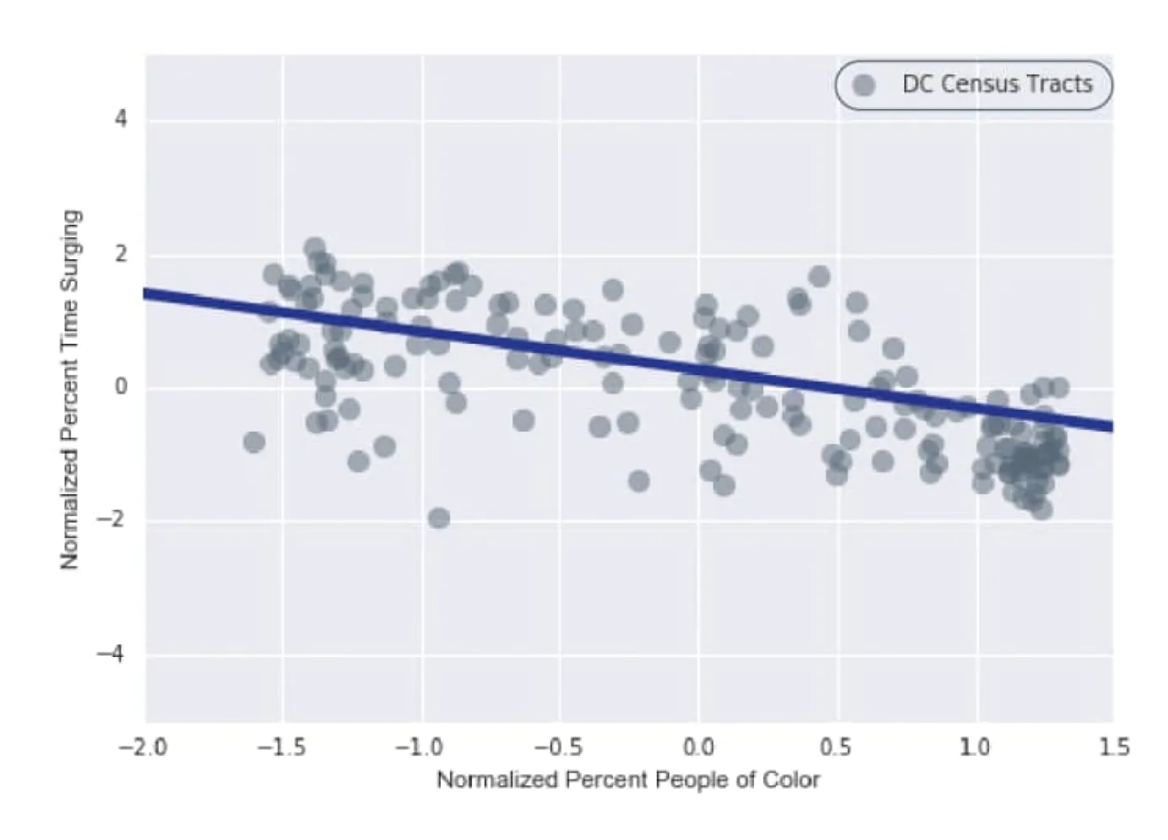
Stories with statistics
https://www.washingtonpost.com/news/wonk/wp/2016/03/10/uber-seems-to-offer-better-service-in-areas-with-more-white-people-that-raises-some-tough-questions/

Slide 7
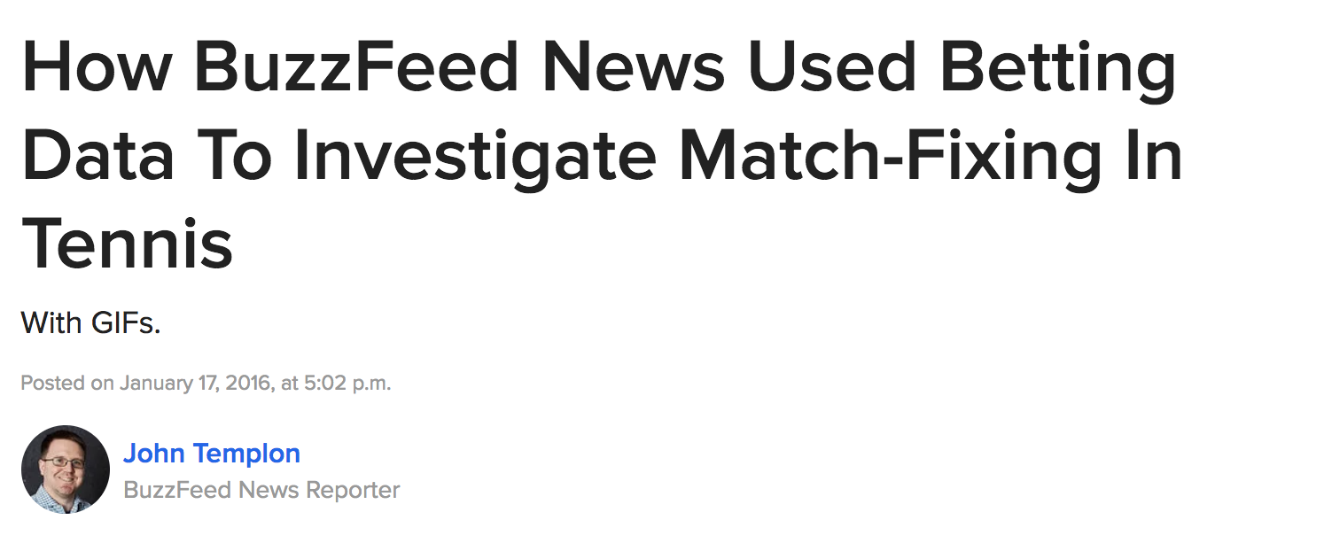

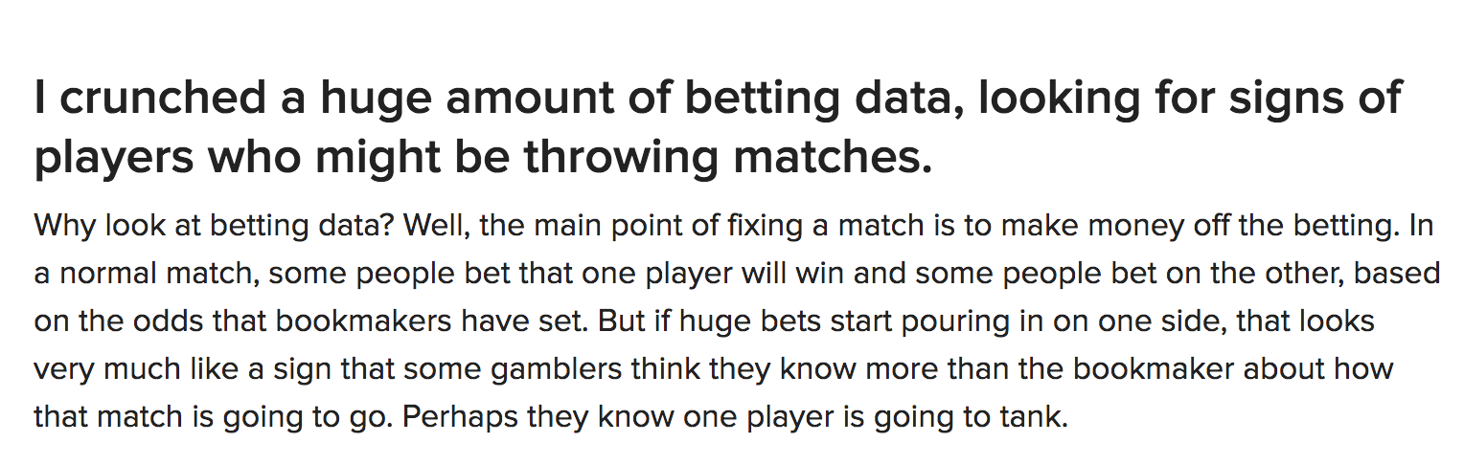
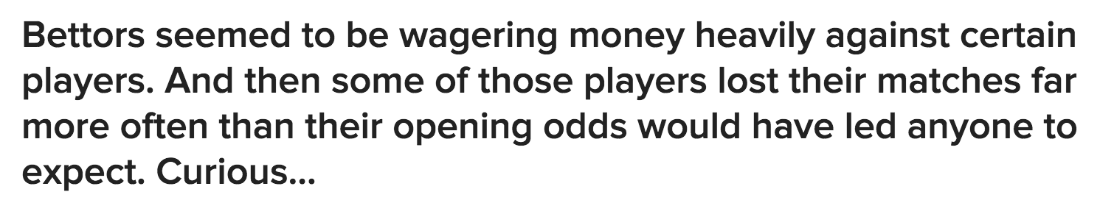
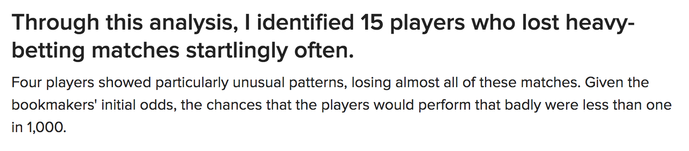
Stories with statistics
https://www.buzzfeed.com/heidiblake/the-tennis-racket?utm_term=.koRMg78M4#.fiob6VAbE

Slide 8
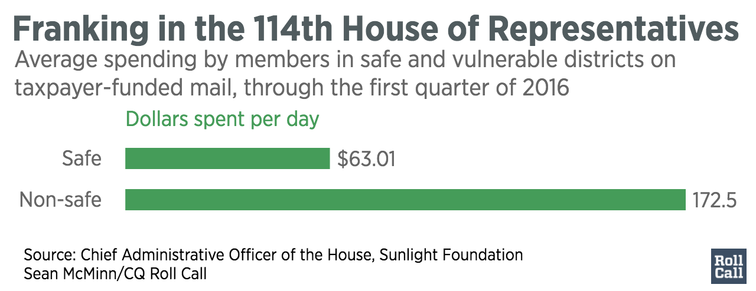
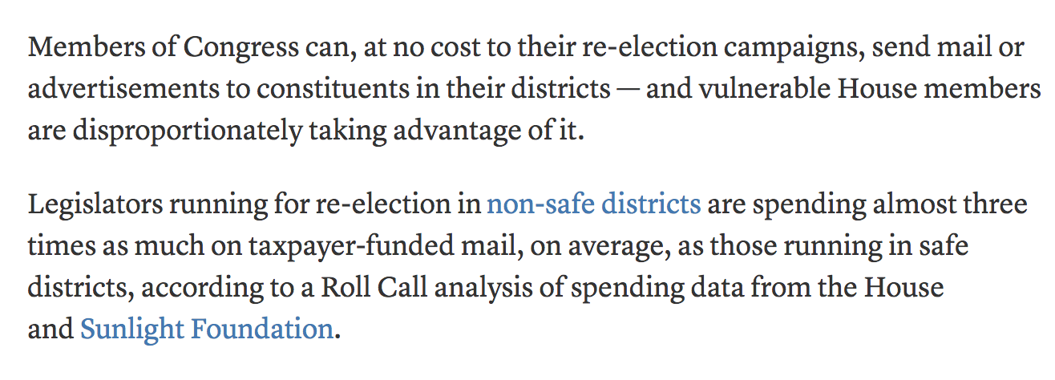
Stories with statistics
http://www.rollcall.com/news/house-members-can-send-mail-taxpayers-dime-vulnerable-ones-much-much

Slide 9
Stories with statistics
http://www.rollcall.com/news/house-members-can-send-mail-taxpayers-dime-vulnerable-ones-much-much

Slide 10
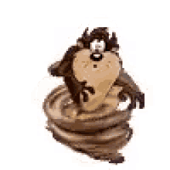
Whilrlwind of statistics
For reporters!

Slide 11
Descriptive statistics
1+2+6+7+9+12+14
Mean
Average
Median
= 7.29
7
1,2,6,7,9,12,14

Slide 12
Descriptive statistics
When to use each?

Slide 13
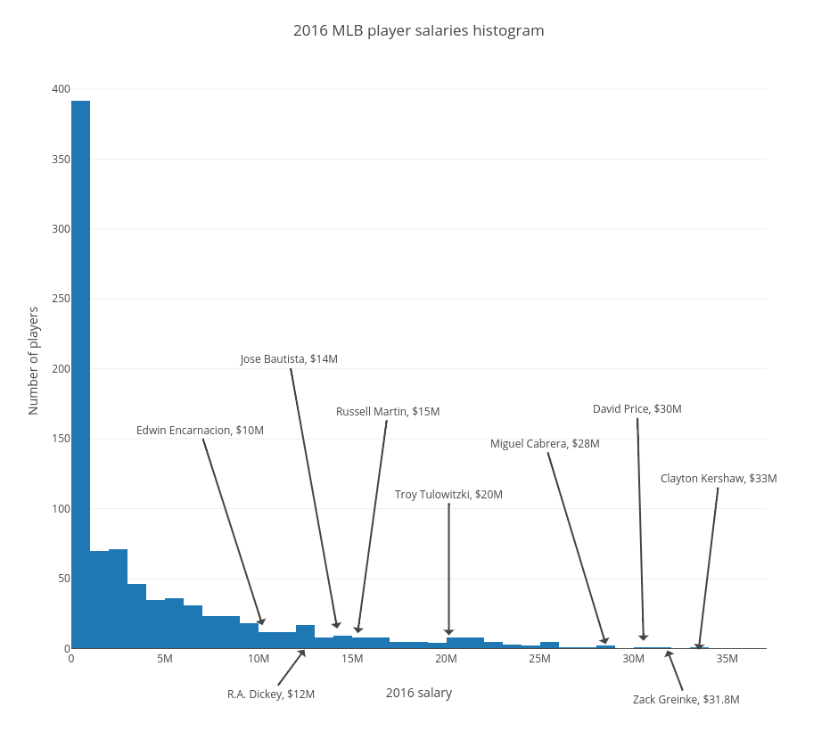
Descriptive statistics
Mean is generally a good bet
Unless …

Slide 14
Descriptive statistics
If data is skewed, mean is not robust to outliers, and will be heavily influenced by them
Instead, use median — which is robust to outliers
~median
~average

Slide 15
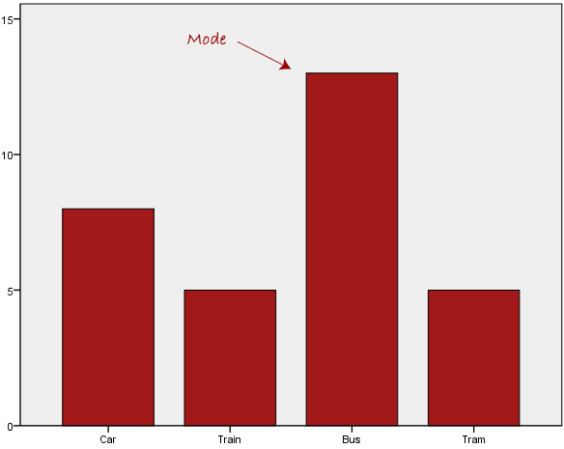
Descriptive statistics
Other descriptive statistics
Mode: most common value
Be careful: mode does not equal “most” or “majority” – more often means “plurality”

Slide 16
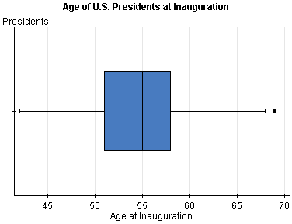
Descriptive statistics
Other descriptive statistics
Quantiles: Range of first quarter of data, second quarter of data, etc…
End of second quantile is also median!

Slide 17
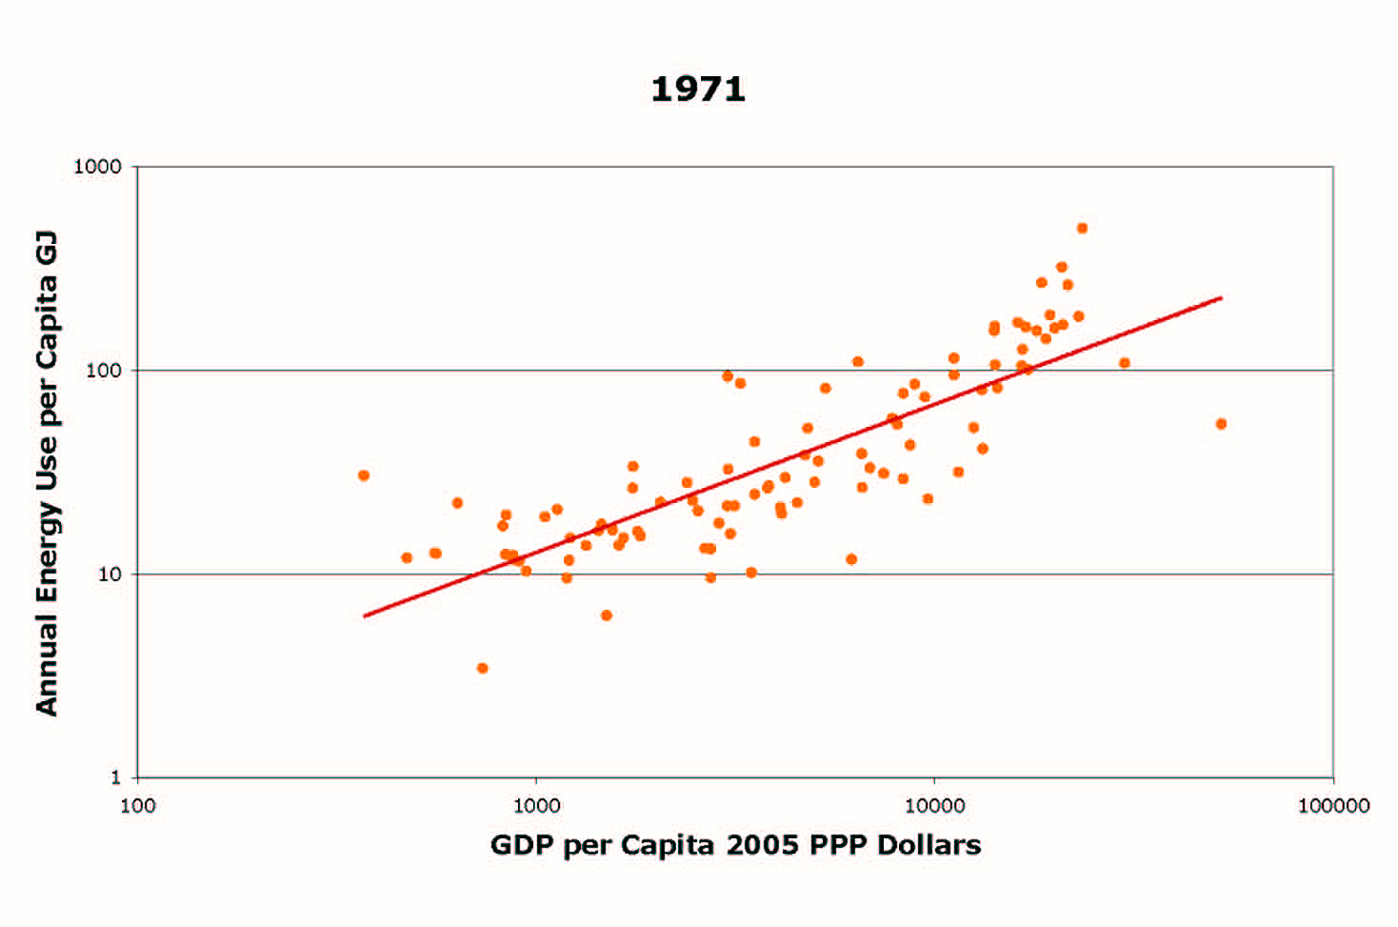
Regression/inference
Can’t survey/sample everybody

Slide 18
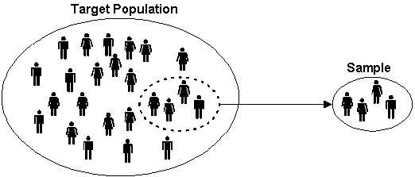
Regression/inference
This is what polling is all about
Use sample mean to infer population mean

Slide 19
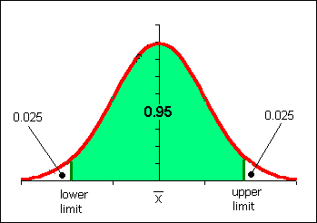
Regression/inference
If we conducted a poll 1,000 times, and the candidates are tied, statistics says the results would fall in the green area 95 percent of the time
Tied results

Slide 20
Regression/inference
If the results fall on either far end of the spectrum, we can say we are 95% confident that the candidates are NOT tied
But what we really want is a number …
Your
results

Slide 21
Margin of error
What determines the margin of error
Bigger sample (number of people polled)
Lower/higher margin of error?
Higher certainty requirement (i.e. 95% vs 90%)
Lower/higher margin of error?

Slide 22
Margin of error
What determines the margin of error
Bigger sample (number of people polled)
Lower/higher margin of error?
Higher certainty requirement (i.e. 95% vs 90%)
Lower/higher margin of error?

Slide 23
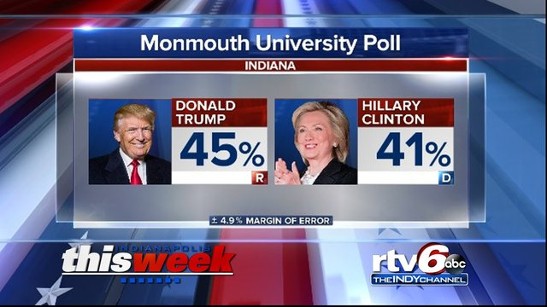
Regression/inference
Standard is to have 95 percent certainty

Slide 24
Regression/inference
So how do we describe this?
40.1%
45%
49.9%
We are 95 percent confident the true percentage of all voters supporting Trump is somewhere between 40.1 and 49.9

Slide 25
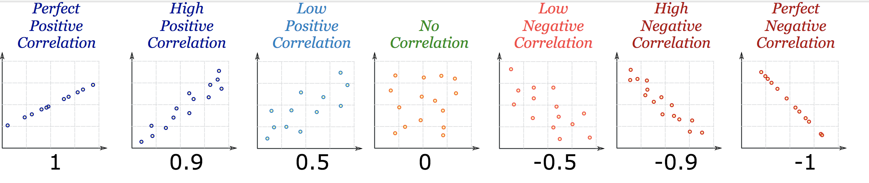
Correlations

Slide 26
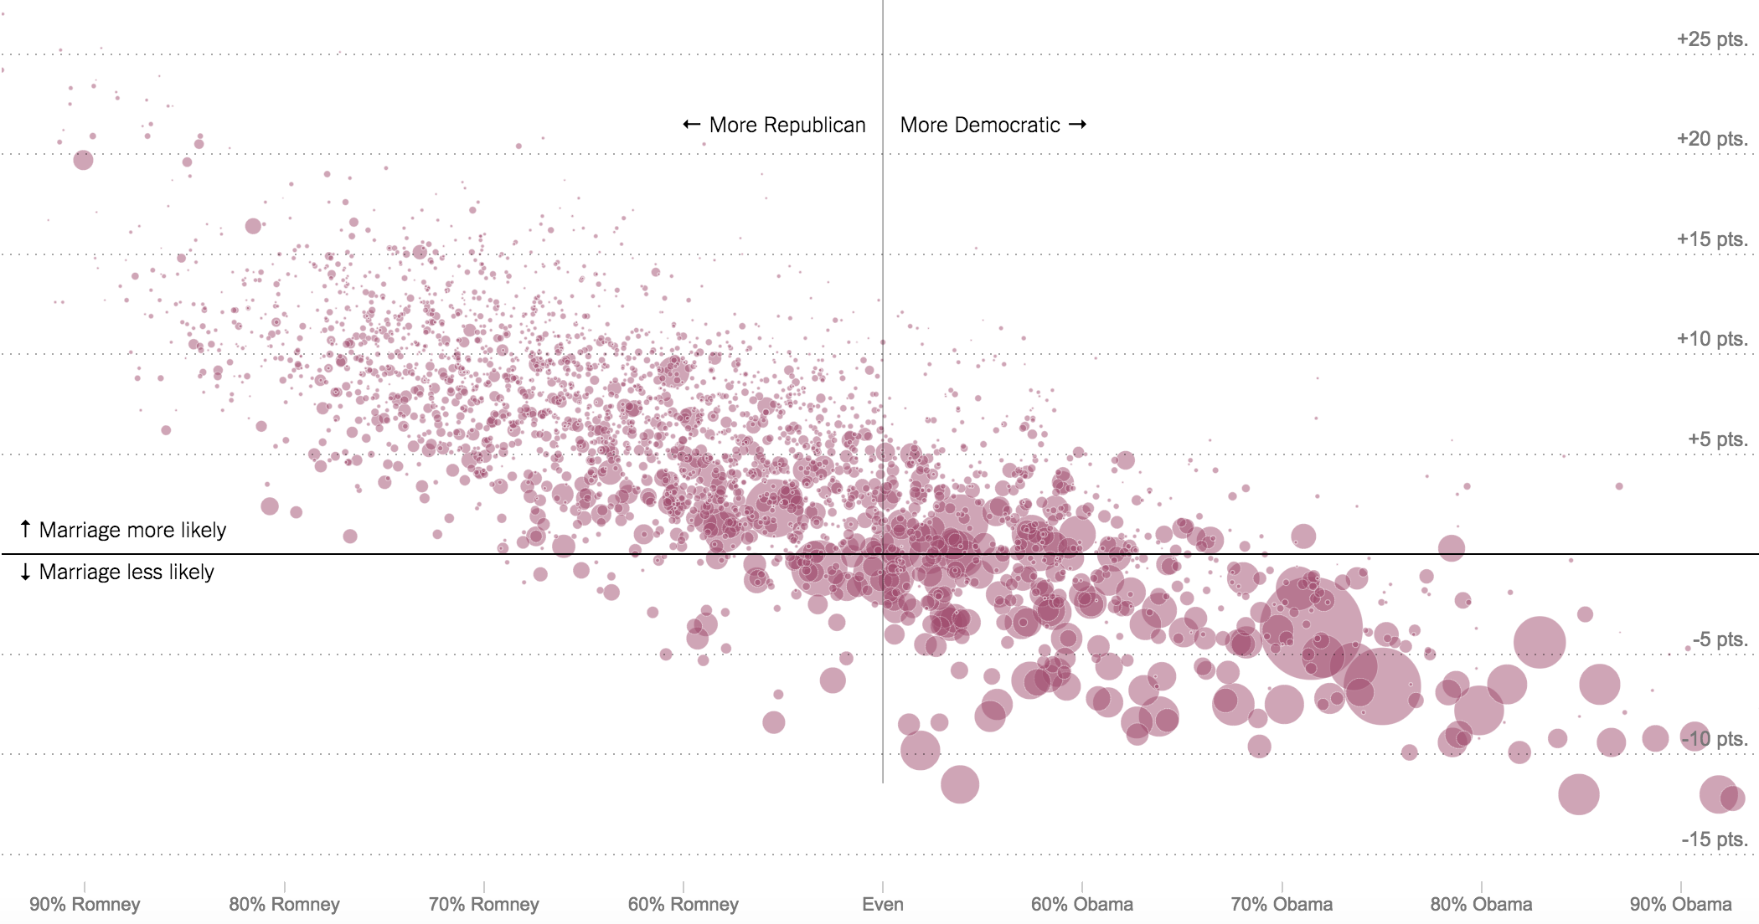
Correlations
What kind of correlation
b/w Democrats and marriage rates?

Slide 27
Correlations
Strong negative correlation

Slide 28
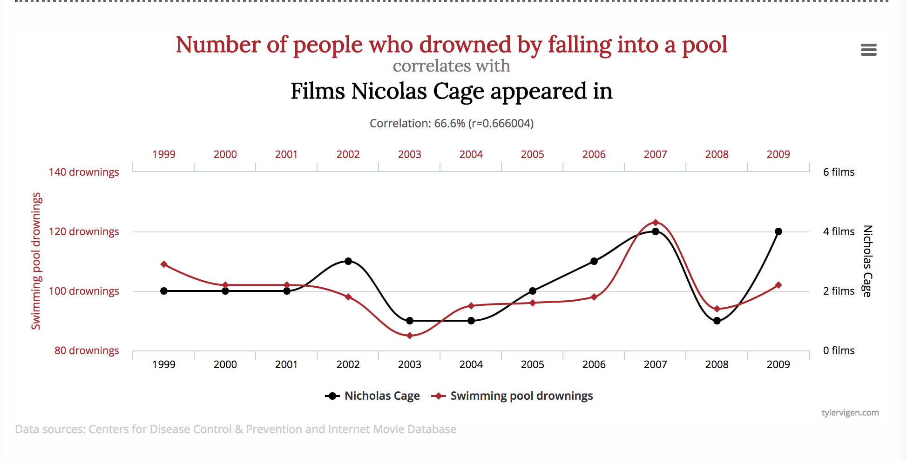
Correlations
Correlation DOES NOT EQUAL causation

Slide 29

Correlations
Correlation DOES NOT EQUAL causation
Need an experiment, not observational survey, to do that

Slide 30
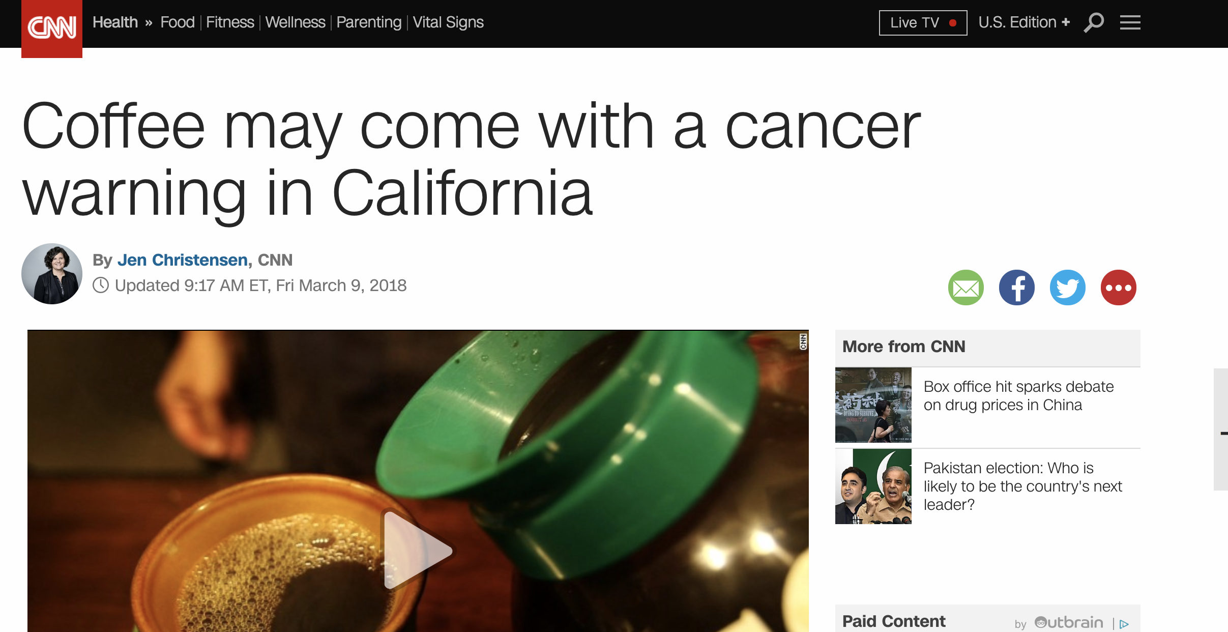
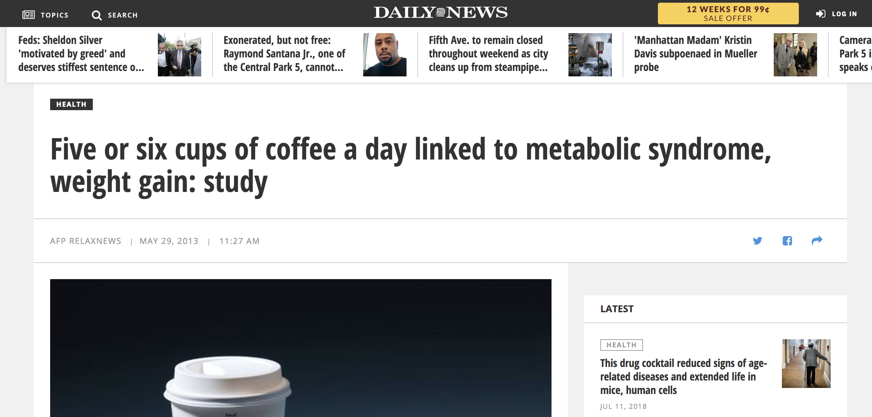
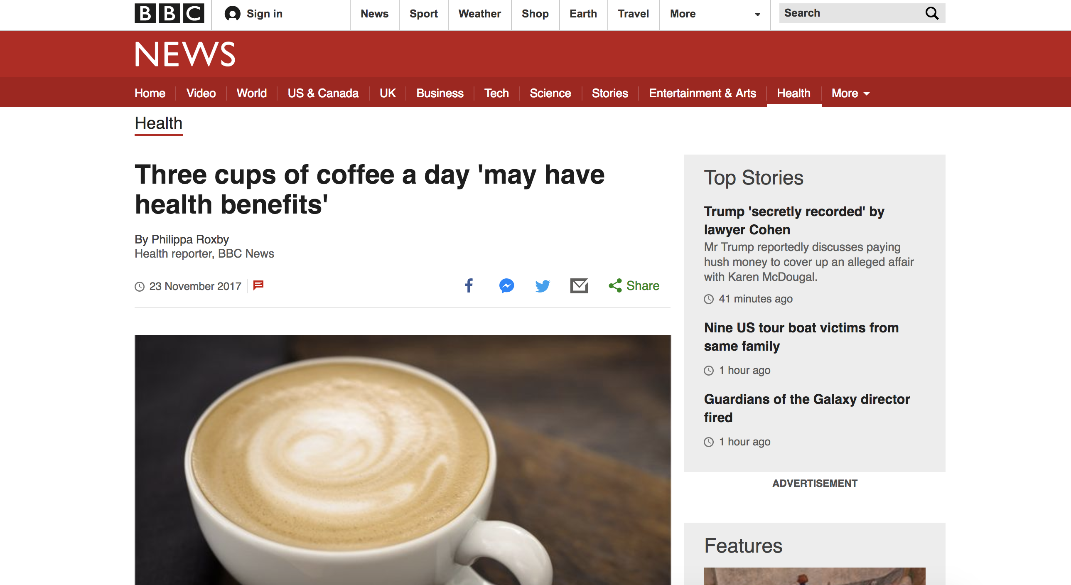
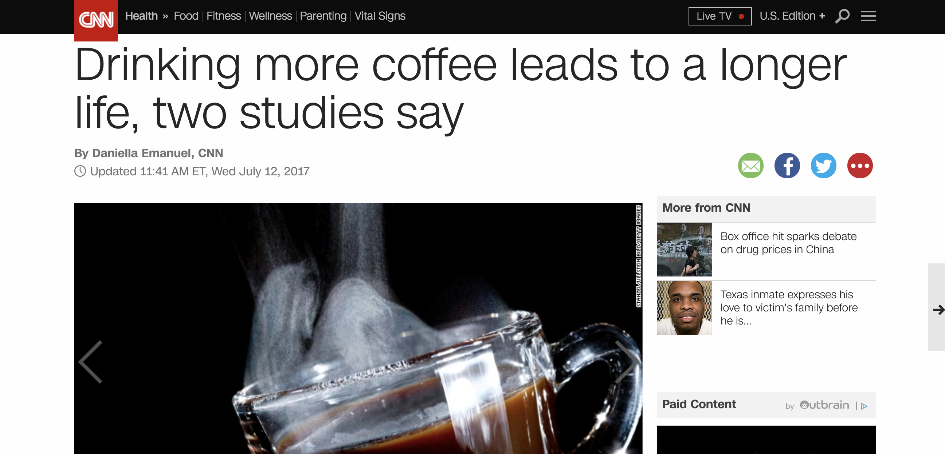
Correlations

Slide 31
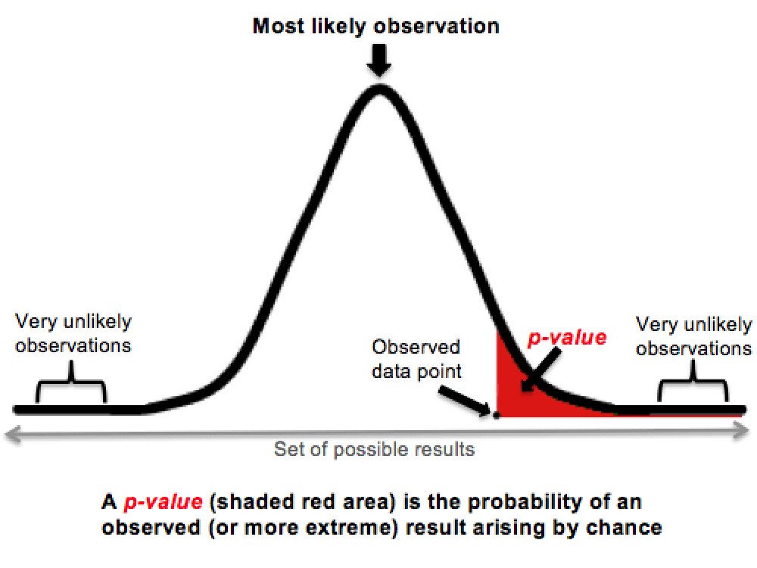
Correlations
P-value tells you if correlation exists by chance, or because there’s actually something there of significance

Slide 32
Correlations
But p-value is hard to explain, and easy to manipulate
https://www.facebook.com/fivethirtyeight/videos/1014409165269579/

Slide 33
Correlations
Example:
(null) hypothesis: Kevin De León and Diane Feinstein are tied in the race for California governor
This is what we are “trying” to disprove

Slide 34
Correlations
Null hypothesis is generally represented by H₀
If H_{o} is true, then 95% of the time, our polling results would be in the middle of the chart distribution

Slide 35
Correlations
Null hypothesis: H₀
If our survey finds Feinstein’s lead is way over here, we have a good idea that it’s statistically significant

Slide 36
Random sample
Without a random sample, nothing else matters because bias!
Probably not random

Slide 37
Random sample
Talk with partner about how these non-random samples could introduce bias
To get monthly grocery spending habits, you survey everyone who stops at the Giant fancy cheese station
To gauge Chicago residents’ position on green energy, you survey every third person who walks by the Navy Pier
To gauge America’s reaction to Trump’s press conference, Breitbart.com puts a poll on its home page

Slide 38
Random sample
Better (but not always practical):
To get monthly grocery spending habits, I use a computer to randomly generate list of 75 shoppers I’ll talk to as they leave the store ( 18th, 22nd, 38th, etc)
To gauge Chicago residents’ position on green energy, I randomly select 200 addresses from the phone book then go to interview the occupants
To gauge America’s reaction to Trump’s press conference, I use random-digit dialing to call 500 Americans

Slide 39
Writing about Stats
To make a very small number more understandable, divide it into 1. For example, .0081 is the proportion of the U.S. population who die every year. 1/.0081 translates to 1 in every 124 Americans die each year.
Limit yourself to no more than 12 digits, including dates such as 2012, in a single paragraph.
-Sarah Cohen, data editor NYT

Slide 40
Writing about Stats
Add context as a proportion of the whole: “At the time of the Million Man March in 1995, a turnout of 1 million black men would have represented 1/12th of all the black men in the country at the time.”
Put things in scale: https://www.youtube.com/watch?v=aKrFFFpYgkU

Slide 41
Percentages
Calculating percentage changes and HELP YOUR COLLEAGUES!
New - old
OR
change
old
old

Slide 42
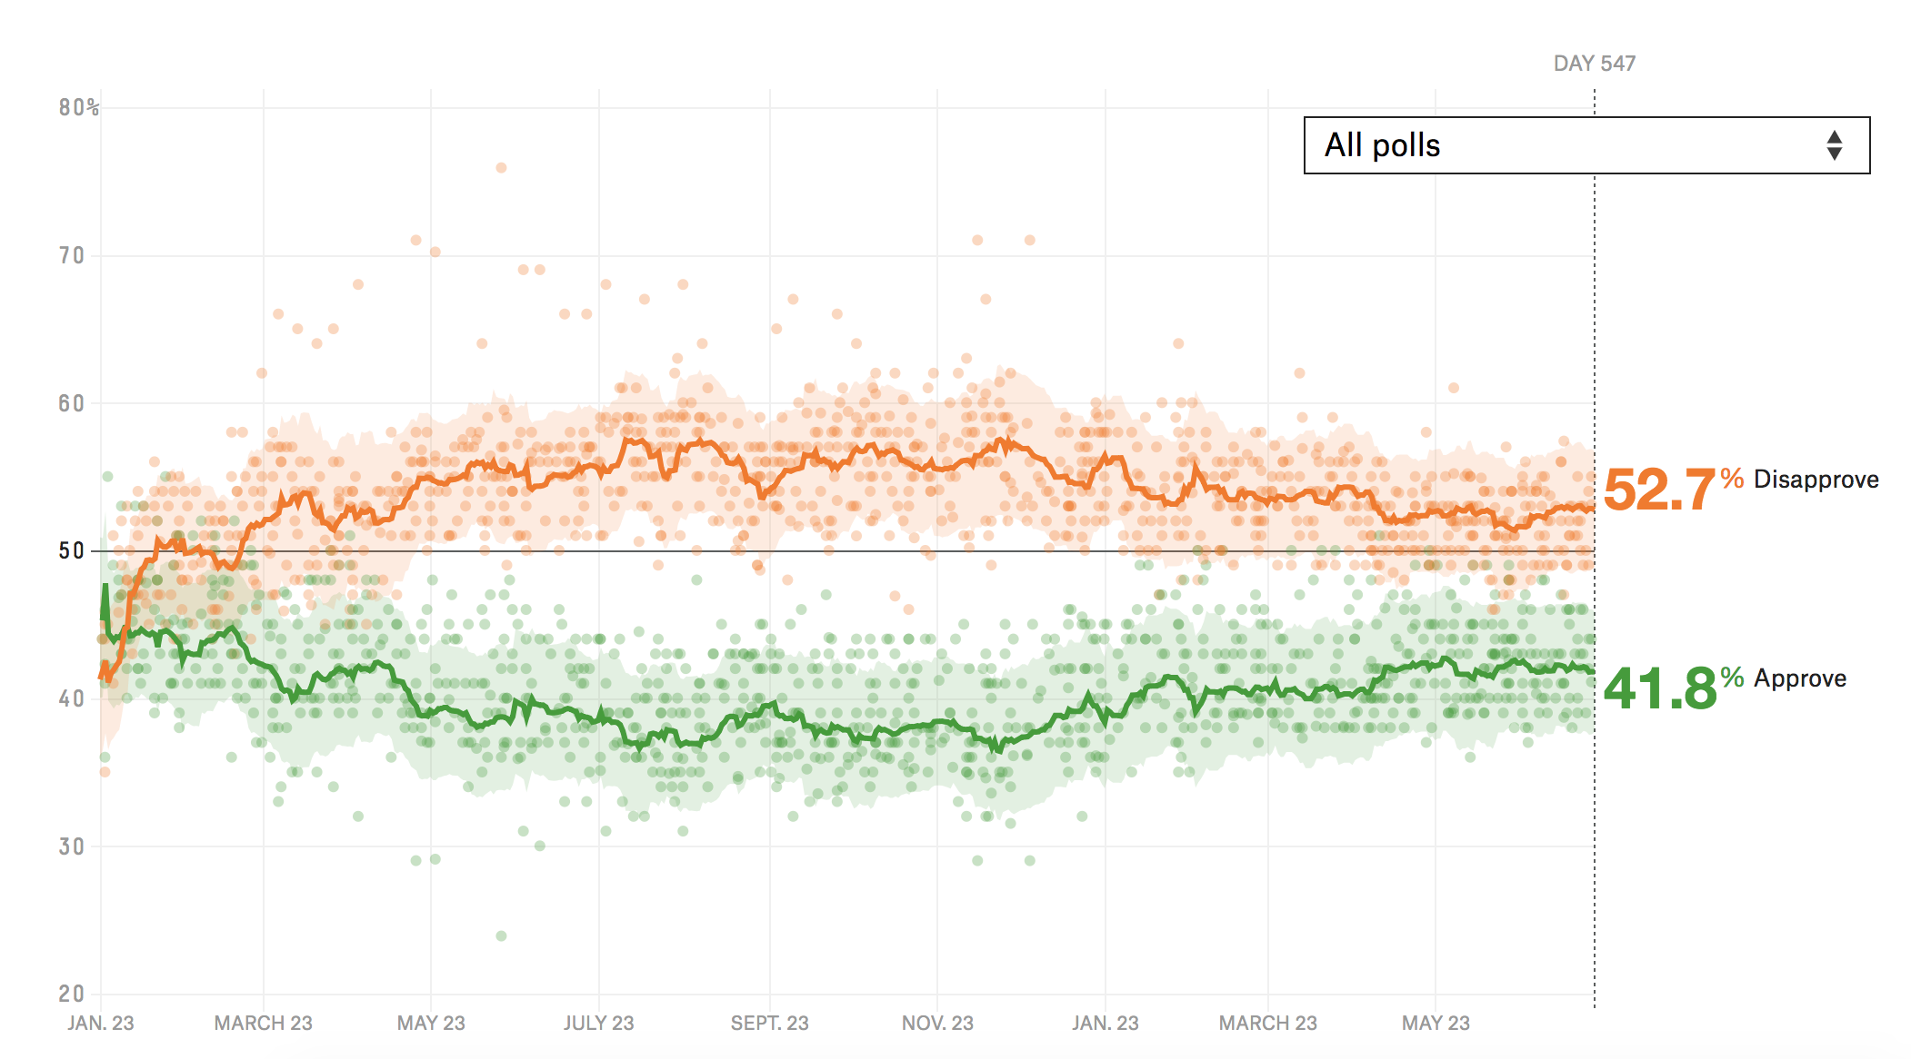
Percentages
Consider changes: percent vs. percent points
Trump approval rating six months ago: 39.5%
Trump approval rating last weekend: 41.8%
+5.8% change
+2.3% points change

Slide 43
Assignment
Finalize your story pitch for the final assignment
Schedule 20 minutes to talk with me on the phone or in person about your story idea

